Slide 1

Stock Analysis(2006-2016) During Financial crisis of 2008
BY: Pranav Somani

Slide 2
Purpose
IDENTIFYING THE TREND OF BANKING STOCKS
DATA FOR THE INSIGHTS
WHAT TREND WE CAN SEE IN FUTURE

Slide 3
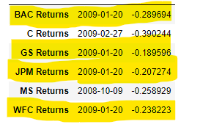
Min return of the day
OBSERVATION: It is found that the worst day for each stock is 20th January 2009.
Reason:
It was the worst inauguration day in US history for stock prices .The new president's inaugural speech briefly lifted shares, although they tumbled downwards as the afternoon progressed.
Obama reasserted his desire for tougher regulation, saying that the present crisis was a reminder that "without a watchful eye, the market can spin out of control".

Slide 4
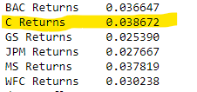
Standard deviation
Citi Bank has the highest standard deviation as it was the most affected.
The share price dropped from $550 to $70 within 2 years.

Slide 5
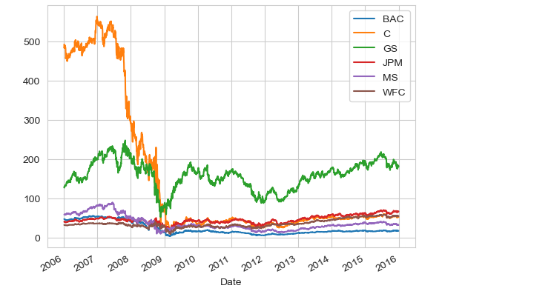
Stock closing price
This confirms Citi bank was the one who was affected a lot.

Slide 6
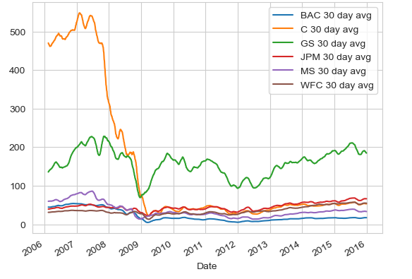
Moving 30 day average

